Slide 1
Chapter 1: Science Skills

Slide 2


Slide 3
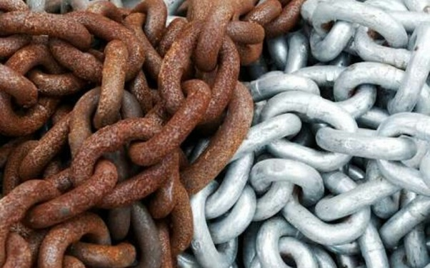

Slide 4
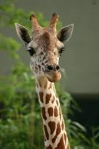
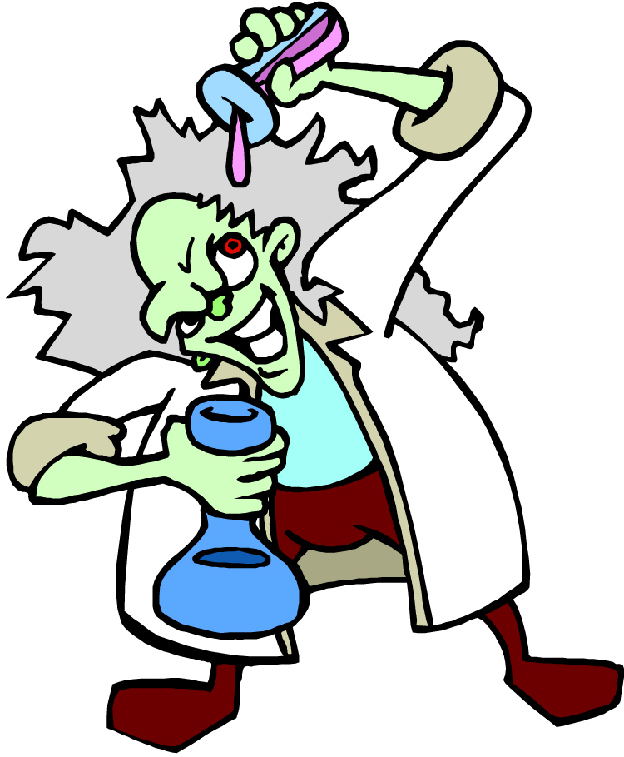
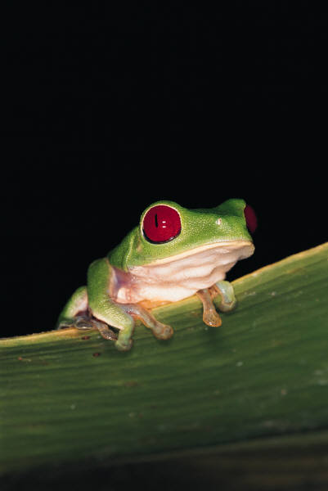
What is Science?
1) The goal of science is to investigate and understand the natural world, to explain events in the natural world, and to use those explanations to make useful predictions.
3. Scientists propose ___________ that can be ______ by examining evidence.
2. Scientists:
explanations
collect and organize information in a careful, orderly way, looking for patterns and connections between events.
tested
4. Science is an organized way of using evidence to learn about the natural world.

Slide 5
A hypothesis is a scientific explanation for a set of observations.
A hypothesis must be stated in a way that makes it “testable”. The hypothesis is just a possible answer to a question, and it must be thoroughly tested.
Hypothesis

Slide 6
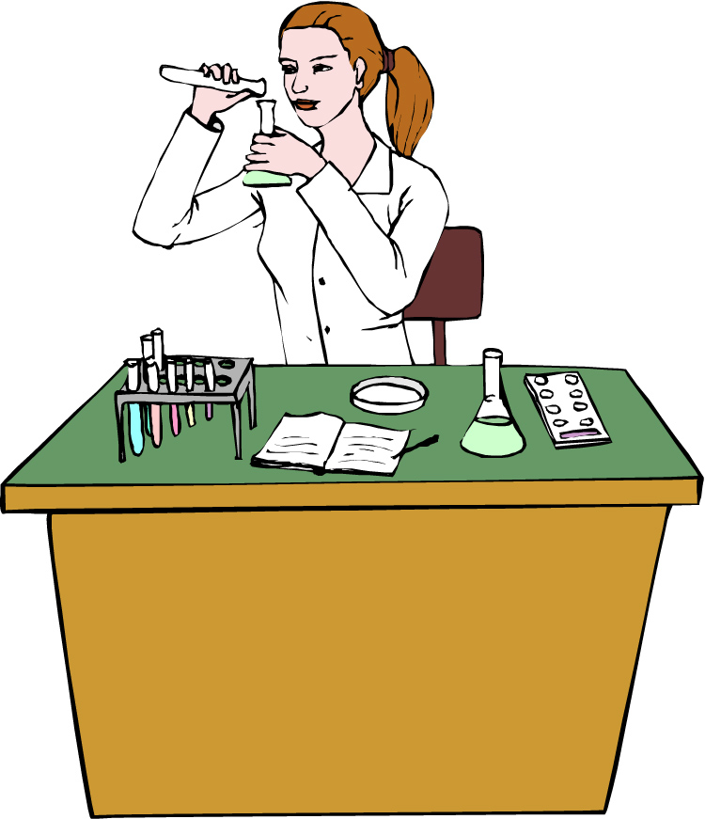
The Scientific Method
A series of steps used by scientists to solve a problem or answer a question.
The Steps to the Scientific Method
Observation
Question
Form a Hypothesis
Experiment
Analyze Data
Conclusion

Slide 7


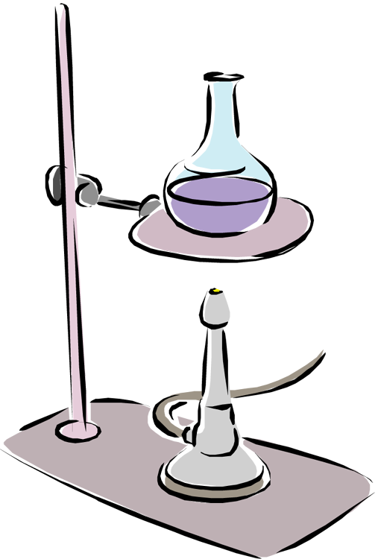
Step 1:
Observation / Asking a Question
Step 2: Form a Hypothesis
Hypothesis
A problem or a question must first be identified.
A possible explanation to the question or problem.
It is simply a prediction and has not yet been proven or disproven.
It must be stated in a way that is testable.
A statement is considered “testable” if evidence can be collected that either does or does not support it.
How much water can a root hair absorb?
Why does a plant stem bend toward the light?
What effect does temperature have on heart rate?

Slide 8
Step 3: Designing a Controlled Experiment
1. The factors in an experiment that can be changed are called variables. Some example of variables would be: changing the temperature, the amount of light present, time, concentration of solutions used.
2. A controlled experiment works with one variable at a time. If several variables were changed at the same time, the scientist would not know which variable was responsible for the observed results.
3. In a “controlled experiment” only one variable is changed at a time. All other variables should be unchanged or “controlled”.
4. An experiment is based on the comparison between a ____________ with an ________________.
control group
experimental group
a) These two groups are identical except for one factor.
b) The control group serves as the comparison. It is the same as the experiment group, except that the one variable that is being tested is removed.
c) The experimental group shows the effect of the variable that is being tested.

Slide 9
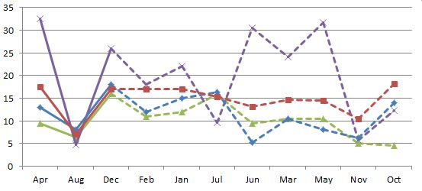
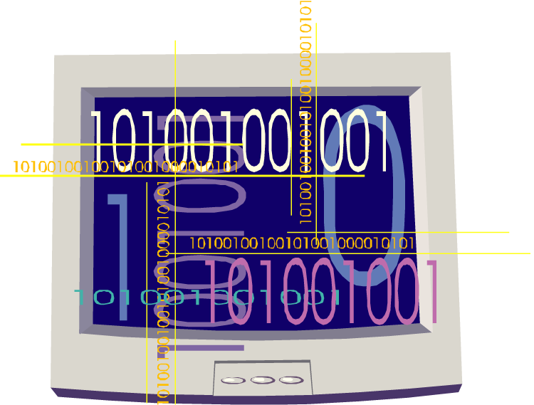
Step 4: Recording and Analyzing Results
1. The data that has been collected must be organized and analyzed to determine whether the data are reliable.

Slide 10
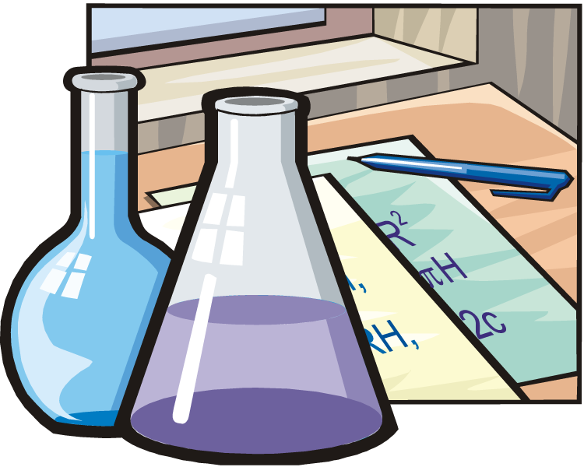
Step 5: Drawing Conclusions
The evidence from the experiment is used to determine if the hypothesis is proven or disproven.
Experiments must be repeated over and over. When repeated, the results should always be the same before a valid conclusion can be reached.

Slide 11
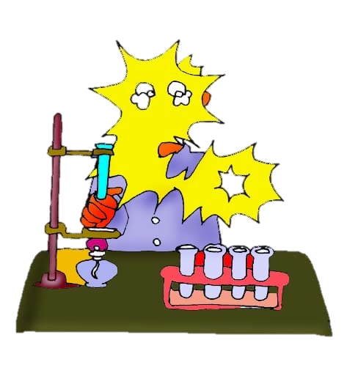
Example: In order to test the effectiveness of a new vaccine, 50 volunteers are selected and divided into two groups. One group will be the control group and the other will be the experimental group. Both groups are given a pill to take that is identical in size, shape, color and texture.
Even though the volunteers are given identical looking pills, the control group will not actually receive the vaccine.
Describe the control group.
Describe the experimental group.
What variables are kept constant?
What variable is being changed?
This group will receive the vaccine.
The size, shape, color, and texture of the pill.
Whether or not the pill contains the vaccine.

Slide 12
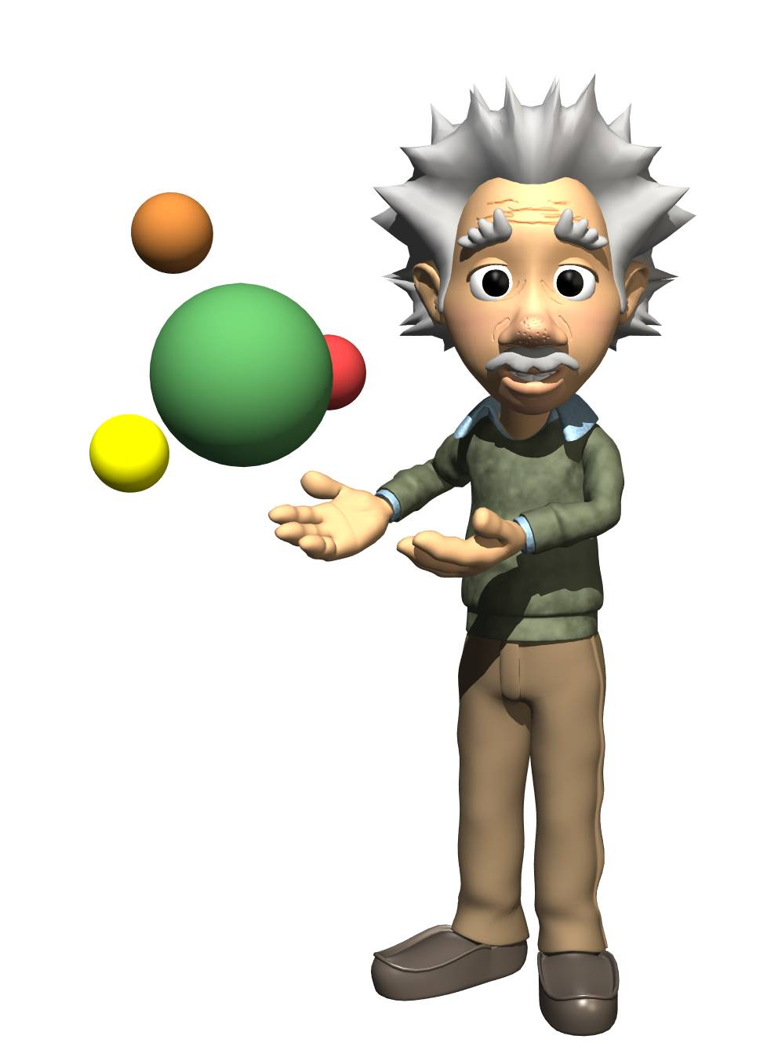
Theory vs. Law
What is the difference between a LAW and THEORY in science?
Theory-has evidence, cannot be proven 100-percent, usually historical
Law-proven over and over

Slide 13
Practice Problem:
You want to determine the effects of a certain fertilizer on the growth of orchids grown in a greenhouse. Materials that are available to you include: greenhouse, 100 orchid plants, water, fertilizer, and soil. You want to know if the orchids will grow best with a weak concentration of fertilizer, a medium concentration of fertilizer, or a high concentration of fertilizer. How will you design an experiment to test different concentrations of this fertilizer?
State your hypothesis:
Possible answer:
I predict that the orchids will grow best with a medium concentration of fertilizer.

Slide 14
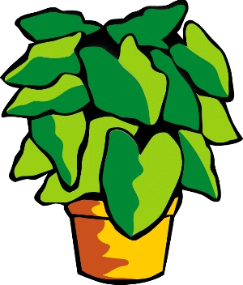
How will you set up a controlled experiment?
Here is one possibility:
The 100 plants will be divided into 4 groups as follows:
Group 1: 25 plants will receive plain water.
Group 2: 25 plants will receive a weak concentration of fertilizer.
The plants will be watered daily.
Over a period of a month, the plants will be measured to see which ones grew the tallest.
Group 3: 25 plants will receive a medium concentration of fertilizer.
Group 4: 25 plants will receive a high concentration of fertilizer.

Slide 15
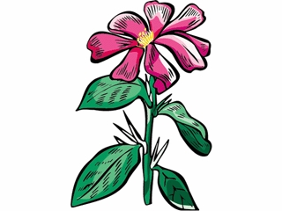
Control Group
Experimental Group
What is the control group in this experiment?
The control group consists of the 25 plants that are receiving plain water.
What is the experimental group in this experiment?
The experimental group consists of the 75 plants that are receiving various concentrations of fertilizer.

Slide 16
In a “controlled experiment”, all variables must be kept constant except the one variable that is being changed.
What variables must be kept constant in this experiment?
All plants must receive the same amount of fluid each day.
All plants are grown in pots of equal size.
All plants are grown at the same temperature.
All plants receive the same amount of sunlight.
What variable is being changed in this experiment?
The variable being changed is the amount of fertilizer received by each group of plants.

Slide 17
After one month of measuring the orchids, the following data is obtained:
Group 1 (Control Group): Grew to an average height of 15 cm.
Group 2 (Weak conc.): Grew to an average height of 35 cm.
Group 3 (Medium conc.): Grew to an average height of 28 cm.
Group 4 (High conc.): Grew to an average height of 10 cm.
Is your hypothesis supported or disproved by these results?
We hypothesized that the orchids would grow best with a medium concentration of fertilizer.
The results do not support this.
The results disprove our hypothesis.

Slide 18
After one month of measuring the orchids, the following data is obtained:
Group 1 (Control Group): Grew to an average height of 15 cm.
Group 2 (Weak conc.): Grew to an average height of 35 cm.
Group 3 (Medium conc.): Grew to an average height of 28 cm.
Group 4 (High conc.): Grew to an average height of 10 cm.
What is your conclusion based on these results?
Orchids grow best with a weak concentration of fertilizer.
At medium to high concentrations, plant growth is inhibited.

Slide 19
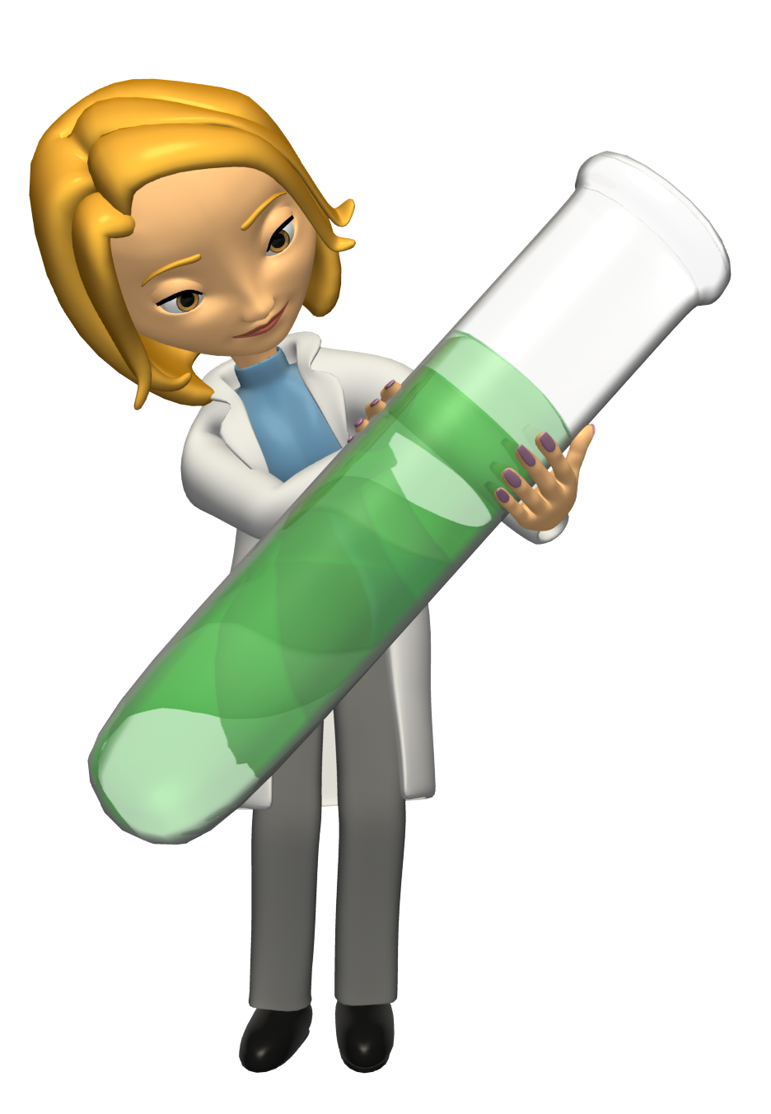
Variables Vocab
Independent (manipulated)-what the scientists changes
Dependent (responding)-what the scientists measures
Control-baseline, do nothing to
Constants-keep the same in lab

Slide 20
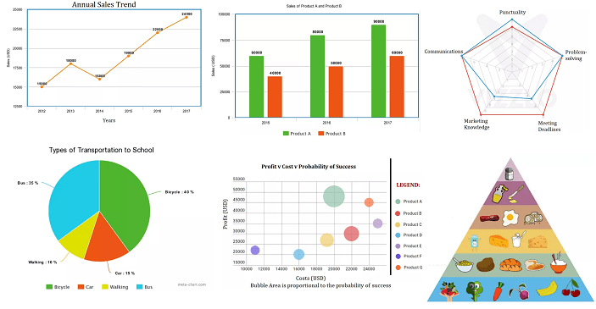
Presenting Your Data

Slide 21
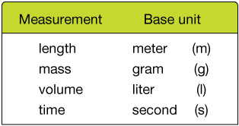
Measurement: English vs. Metric

Slide 22
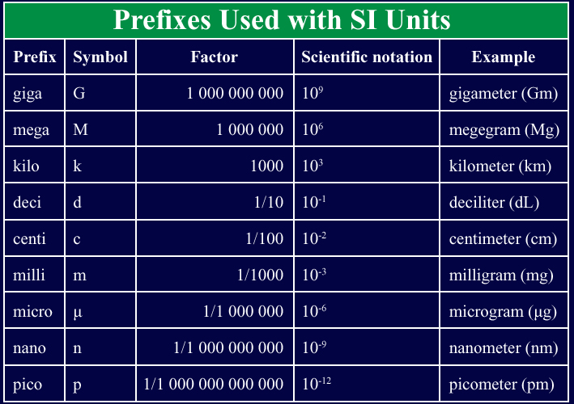

Slide 23
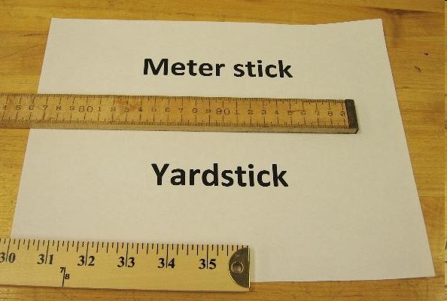
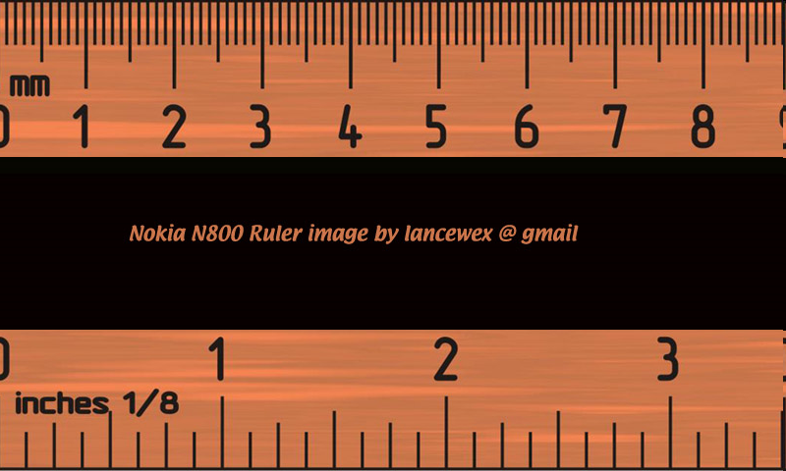
English vs. Metric Units of Length
Which is longer?
A. 1 mile or 1 kilometer
B. 1 yard or 1 meter
C. 1 inch or 1 centimeter
1 mile
1.6 kilometers
1 inch = 2.54 centimeters
1 yard = 0.9444 meters

Slide 24
Length
The basic unit of length in the metric system in the meter and is represented by a lowercase m.
TRIVIA! Which is larger?
A. 1 meter or 105 centimeters
B. 4 kilometers or 4400 meters
C. 12 centimeters or 102 millimeters
D. 1200 millimeters or 1 meter

Slide 25
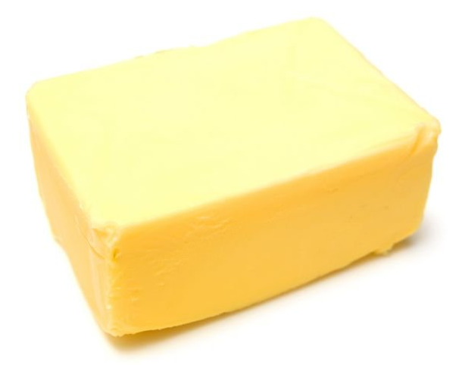
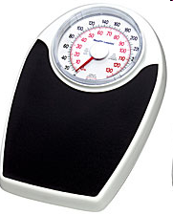
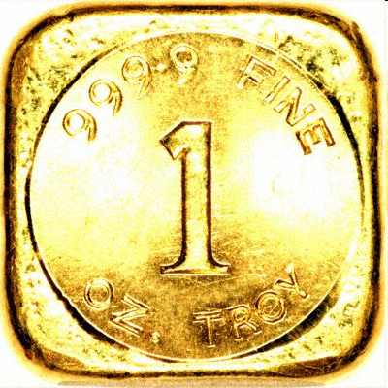
English vs. Metric Units of Mass
TRIVIA: Which is larger?
1. 1 Pound or 100 Grams
2. 1 Pound or 1 Kilogram
3. 1 Ounce or 1000 Milligrams
1 pound = 453.6 grams
1 ounce of gold = 28,349.5 milligrams
1 kilogram =
2.2 pounds

Slide 26
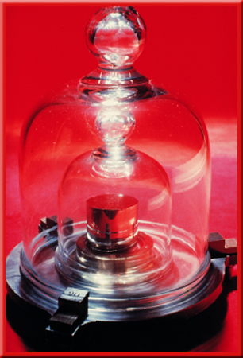
Mass
Mass refers to the amount of matter in an object.
g
kg
mg
cg
TRIVIA! Which is larger?
A. 1 kilogram or 1500 grams
B. 1200 milligrams or 1 gram
C. 12 milligrams or 12 kilograms
D. 4 kilograms or 4500 grams

Slide 27
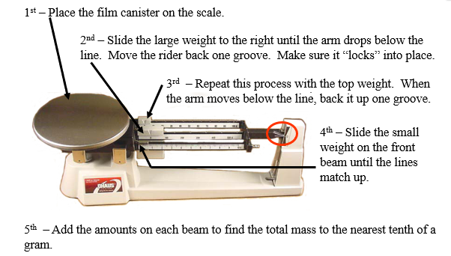
Measuring Mass

Slide 28
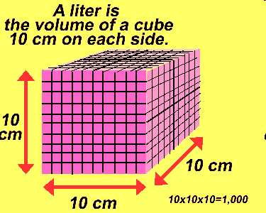
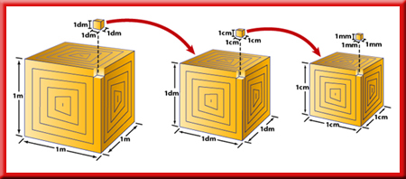
Volume
Volume is the space occupied by an object.
The base unit of volume in the metric system in the liter and is represented by L or l.

Slide 29

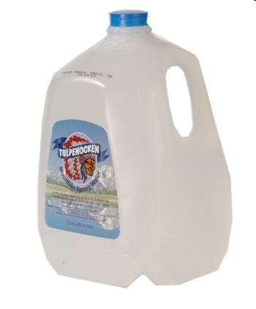
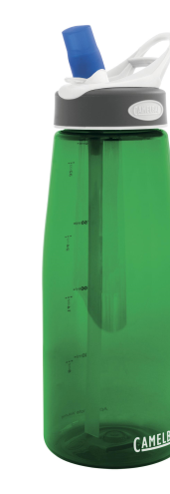
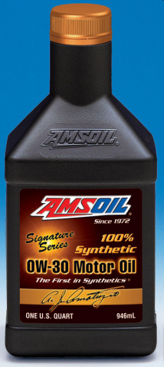
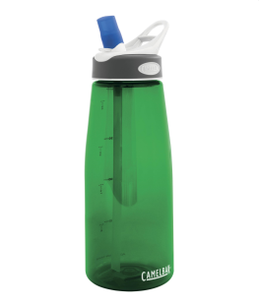
English vs. Metric Units of Volume
Which is larger?
A. 1 liter or 1 gallon
B. 1 liter or 1 quart
C. 1 milliliter or 1 fluid ounce
1 fl oz = 29.573 ml
1 12-oz can of soda would equal approximately 355 ml.
1 gallon = 3.79 liters
1 quart = 0.946 liters
It would take approximately 3 ¾ 1-liter bottles to equal a gallon.

Slide 30
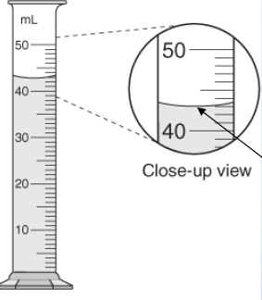
Measuring Volume
We will use graduated cylinders to find the volume of liquids and other objects.
Read the measurement based on the bottom of the meniscus or curve. When using the real cylinder, make sure you are eye-level with the water

Slide 31
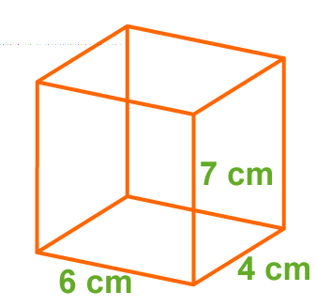
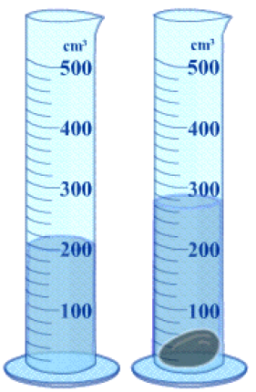
Measuring Volume
We can measure the volume of a regular object using the formula
length x width x height
We can measure the volume of irregular
object using water displacement.
Amount of water without object: Amount of water with object: Difference = Volume:

Slide 32
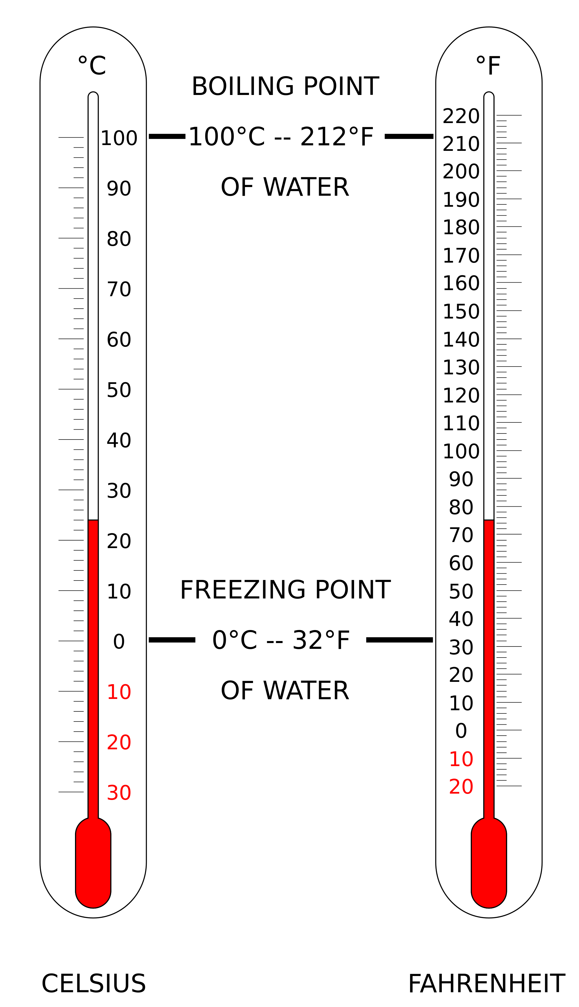

Slide 33
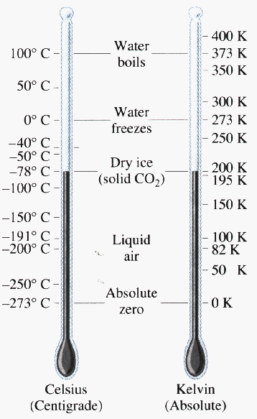
Temperature
Scale #2: The Kelvin scale
Devised by a Scottish physicist and mathematician, William Thomson, who was known as Lord Kelvin.
A kelvin (K) is the SI base unit of temperature.
On the Kelvin scale, water freezes at about 273 K and boils at about 373 K.

Slide 34
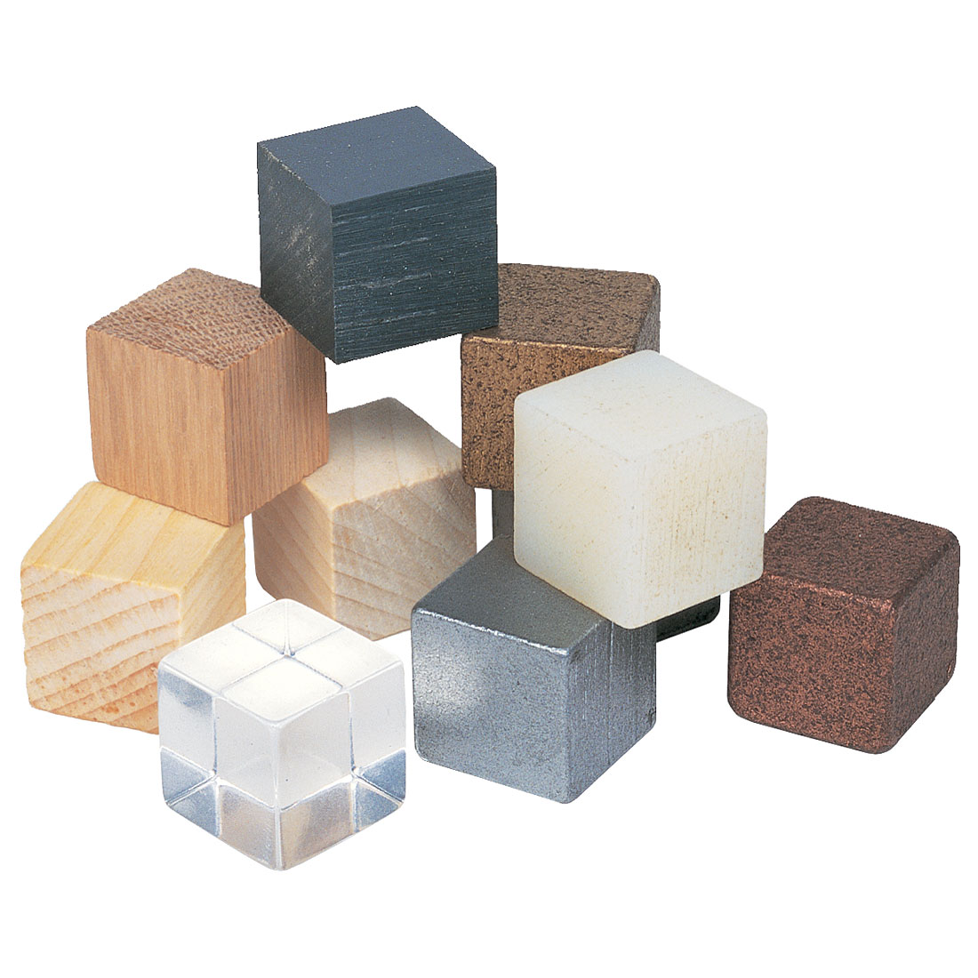
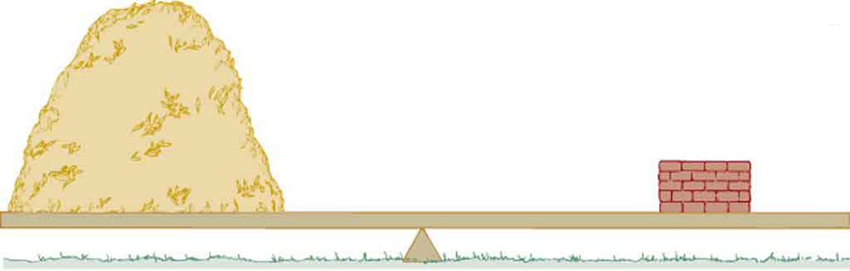
  Density= Mass/Volume
Comparison of how much space a particular amount of matter occupies – how packed or crowded (feathers vs. lead).
Each material has a unique density that can be used to identify it

Slide 35
M
D
=
V
Density Units:
g/cm³ or g/mL

Slide 36
Example 1: Calculate the density of a substance with a
mass of 24.3 g and a volume of 32.9 mL.

Slide 37
Example 1: Calculate the density of a substance with a
mass of 24.3 g and a volume of 32.9 mL.
0.739 g/mL

Slide 38
Example 2: What is the mass of an object with a
density of 1.25 g/mL and a volume of 227 mL.

Slide 39
Example 2: What is the mass of an object with a
density of 1.25 g/mL and a volume of 227 mL.
284 grams

Slide 40
Example 3: What is the volume of an object with a
density of 0.835 g/mL and a mass of 55.5
grams?

Slide 41
66.5 mL
Example 3: What is the volume of an object with a
density of 0.835 g/mL and a mass of 55.5
grams?

Slide 42
Example 4
Which has greater density:
- Object A with a mass of 12.3 g and a volume of 3.5 cm³
- Object B with a mass of 12.3 g and a volume of 2.0 cm³

Slide 43
Example 4
Which has greater density:
- Object A with a mass of 12.3 g and a volume of 3.5 cm³
- Object B with a mass of 12.3 g and a volume of 2.0 cm³
Object B

Slide 44
Example 5
Which has greater density
- Substance A with a mass of 25.0 g and a volume of 5.0 mL
- Substance B with a mass of 20.0 g and a volume of 5.0 mL

Slide 45
Example 5
Which has greater density
- Substance A with a mass of 25.0 g and a volume of 5.0 mL
- Substance B with a mass of 20.0 g and a volume of 5.0 mL
Substance A

Slide 46
Scientific Notation
Scientific notation expresses numbers as a multiple of two factors:
  a number between 1 and 10
  ten raised to a power, or exponent.
The exponent tells you how many times the first factor must be multiplied by ten.
Numbers larger than 1: power of ten is positive.
Numbers smaller than 1: power of ten is negative.

Slide 47
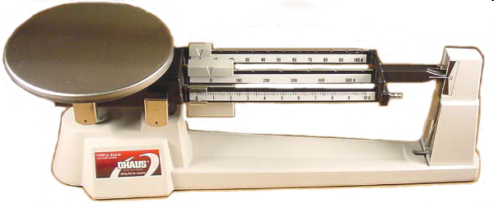
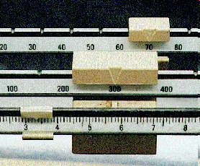
Measuring Mass
We will be using triple-beam balances to find the mass of various objects.
The objects are placed on the scale and then you move the weights on the beams until you get the lines on the right-side of the scale to match up.
Once you have balanced the scale, you add up the amounts on each beam to find the total mass.
What would be the mass of the object measured in the picture?
_______ + ______ + _______ = ________ g
Top Image: http://www.southwestscales.com/Ohaus_Triple_Beam_750-SO.jpg
Bottom Image: http://www.regentsprep.org/Regents/biology/units/laboratory/graphics/triplebeambalance.jpg

Slide 48
Measuring Mass – Triple-Beam Balance
1st – Place the film canister on the scale.
2nd – Slide the large weight to the right until the arm drops below the line. Move the rider back one groove. Make sure it “locks” into place.
3rd – Repeat this process with the top weight. When the arm moves below the line, back it up one groove.
4th – Slide the small weight on the front beam until the lines match up.
5th – Add the amounts on each beam to find the total mass to the nearest tenth of a gram.

